Slide 1


Quiz & Fun Riddles
Arun & James

Slide 2

A woman and friends are under umbrella, but nobody get’s wet. Why ?
Because it wasn’t raining

Slide 3
What are the next two letters ? J, F, M,A,M,J, _ _
J, A
January, February, March, April, May, June, July, August

Slide 4
What are the next two letters ? J, F, M,A,M,J, _ _
J, A
January, February, March, April, May, June, July, August

Slide 5

How many months have 28 days ?
All months have 28 days.

Slide 6
What are the next letters in this and why ? W, A, T, N , L, I, T, _ _
A, W
What are the next letters in this and why ?

Slide 7
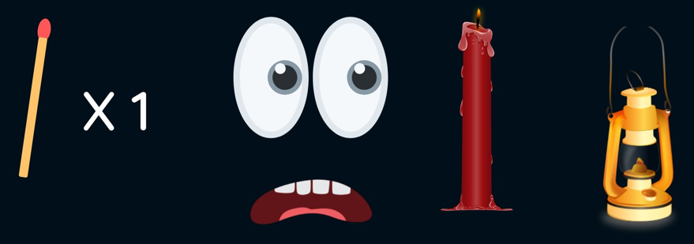
You enter a dark room. There is a candle and lantern. You only have ONE match. Which one do you light first ?
The Match

Slide 8
I speak without a mouth and hear without ears. I have no body, but I come alive with the wind. What am I?
An Echo

Slide 9
The more of this there is, the less you see. What is it?
Darkness

Slide 10
I’m tall when I’m young, and I’m short when I’m old. What am I?
A Candle

Slide 11
What can travel around the world while staying in the same spot?
A Stamp

Slide 12
I have branches, but no fruit, trunk, or leaves. What am I?
A Bank

Slide 13
What has many hearts but no organs?
A Deck of Cards

Slide 14
What comes once in a minute, twice in a moment, but never in a thousand years?
The letter "M"

Slide 15
If you drop me, I’m sure to crack, but give me a smile, and I’ll always smile back. What am I?
A Mirror

Slide 16
What can fill a room but takes up no space?
Light

Slide 17
The more you have of it, the less you see. What is it?
Fog

Slide 18

Riddles

Slide 19
A cop tries to save his estranged wife and other hostages held by terrorists in a skyscraper. What is the movie?
Die Hard

Slide 20
A scientist who turns into an uncontrollable creation when exposed to emotions. What is the movie?
Enthiran

Slide 21
A group of superheroes come together to stop a powerful villain who seeks to collect stones to control the universe. What is the movie?
Avengers: Infinity War

Slide 22
A man with extraordinary memory seeks revenge for the murder of his wife, but his methods are unconventional. What is the movie?
Ghajini

Slide 23
A revolutionary leader unites tribes and commoners to challenge a tyrannical government, leading them into a freedom movement. What is the movie?
RRR

Slide 24
A dual life – an everyday common man and a don. Only one man is aware of the truth behind this duality. What is the movie?
Aalavandhan

Slide 25
: He’s a former hitman who seeks vengeance after the loss of his beloved dog. Who is he?
John Wick

Slide 26
A group of friends embarks on an adventurous road trip, but what begins as fun turns into a life-changing experience. What is the movie?
Saroja

Slide 27
A former athlete who lost everything in his youth finds his redemption in training the next generation of sports champions. What is the movie?
Irudhi Suttru

Slide 28
A brilliant detective with a penchant for puzzles, he solves crimes while battling his own demons. Who is he?
Sherlock Holmes

Slide 29
I tell the story of a talented cricketer who returns to the game after years of struggle to fulfill his son's dreams. My title is inspired by a piece of sportswear. What movie am I?
Jersey

Slide 30
I tell the story of a man who faces incredible challenges and adventures in a foreign land, all while seeking freedom and hope. My title refers to a lively animal that represents resilience and survival. What movie am I?
Aadujeevitham: The Goat Life

Slide 31


